Slide 1
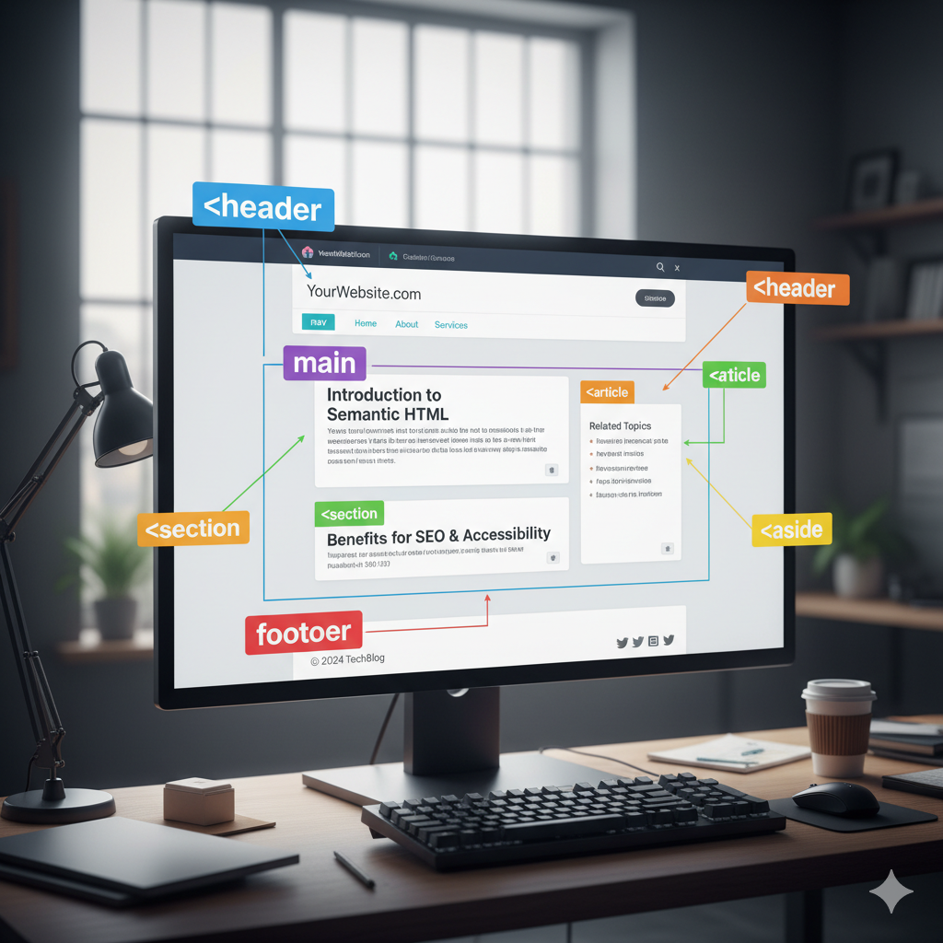
SEMANTIC SECTIONING
Maximilian Kirsh, SEWD1 2025

Slide 2
What is it?
Describing the meaning of the content clearly for search engine optimization. Tags such as <header>, and <nav> define a specific purpose of the content

Slide 3
Key Terms and Elements
<header> is the container for the introductory of the page
<nav> is the navigation tag that helps jump from different parts of the page easily
<section> is the divider of content within a page. It makes things more organized

Slide 4
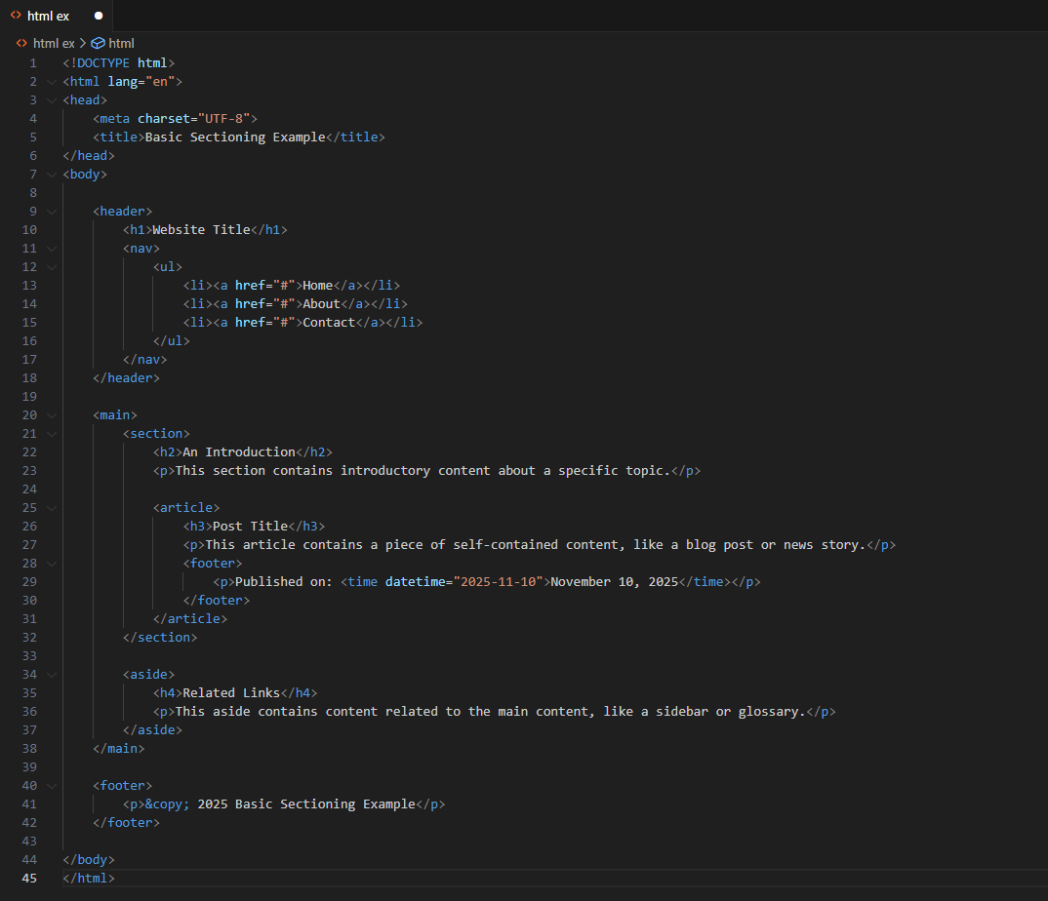
Visual Example/Code Snippet

Slide 5
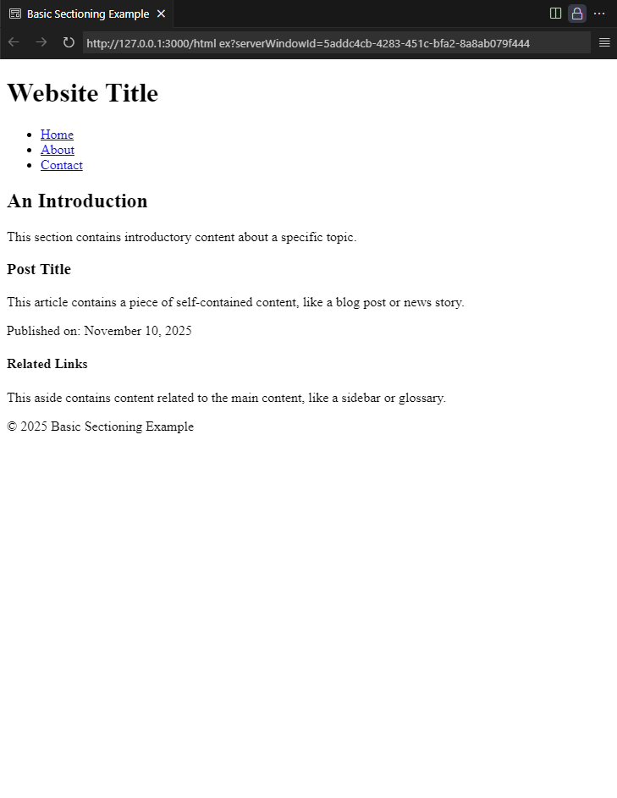
Applied Example

Slide 6
Common Mistakes/Tips
Using a <div> tag for content that has clear semantic purpose
Using <section> to wrap an element that could have a more specific tag
Confusing <article> and <section> tags. <article> is a single piece of content, while <section> is a grouping of content.

Slide 7
Key Takeaways
Section is VERY important in a webpage because it:
Organizes your content
Gives specific meaning to individual pieces of content
Helps build fundamental organization within your projects

